Slide 1
Lab 12 Advanced SQL 2
United International College
COMP3013 DBMS

Slide 2
Outline
Triggers
Triggers - Event, Condition and Action
Triggers in SQL
Triggers Example, Row-Level and Statement-Level
Tricky Design Issues
Triggers Example, More
Triggers in MySQL, More
Triggers Example with UIC Database
Revisions

Slide 3
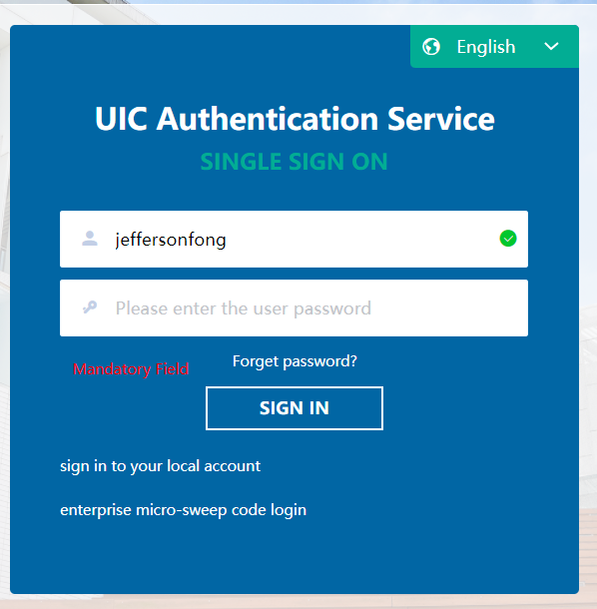
Triggers – Event, Condition and Action
For some simple condition checking within one table, we can use CHECK. But, for a complicated predicate crossing multiple tables, we need to use TRIGGER.
A trigger is a statement that the system executes automatically as a side effect of a modification to the database.
Reference: MySQL reference manual and [5.3] of textbook.
We need two things:
Specify when a trigger is to be executed, event and condition.
Specify the actions to be taken when the trigger executes.
Event-Condition-Action (non-database) example
Event – Click “SIGN IN” button
Condition1 – User name and password are correct
Action1 – Display the user’s UIC webpage
A different condition would trigger another action.

Slide 4
Triggers – Event, Condition and Action
Event-Condition-Action rules:
When event occurs, check the condition; if true, do the actions.
Move monitoring logic from apps into DBMS.
Enforce constraints
beyond what constraint system supports and
automatic constraint “repair”.

Slide 5
Syntax
An trigger in SQL takes the form
CREATE TRIGGER <trigger-name>
BEFORE/AFTER <event>
FOR EACH ROW
<Trigger body>
BEFORE or AFTER specifies when the trigger is activated.
<event> can be INSERT, DELETE, or UPDATE.
FOR EACH ROW is a fixed phrase.
<Trigger body> specifies the actions will be taken if some conditions are satisfied.

Slide 6
Syntax
The body of a trigger can contains
referencing variables
OLD.<column name> refers to old rows for deletion or update events.
NEW.<column name> refers to new rows for insertion or update events.
data modification statements
INSERT, DELETE, or UPDATE like other SQL statements
Construct
Quoted by BEGIN and END
Details will be given later.

Slide 7
Example with UIC Database
Referential Integrity
ALTER TABLE student ADD CONSTRAINT student_program
FOREIGN KEY p_code REFERENCES program(p_code)
ON DELETE CASECADE
which can be implemented using a trigger
CREATE TRIGGER delete_program_student
AFTER DELETE ON program
FOR EACH ROW
DELETE FROM student
WHERE student.p_code = old.p_code

Slide 8
Construct
Some complicated constraints on multiple tables have to use BEGIN…END construct.
Each statement in the construct must be ended with “;”
Which creates a conflict to the delimiter of an SQL query.
Thus, DELIMITER is used to change the delimiter before and after a trigger in SQL.
For example, we change the delimiter from “;” to “|”.
DELIMITER |
<trigger> |
DELIMITER ;

Slide 9
Conditional Statement
Suppose we want to make sure that every CST student has a GPA at least 1.0
A conditional statement can be used.
The entire trigger is
DELIMITER |
CREATE TRIGGER cst_student
AFTER INSERT ON student
FOR EACH ROW
BEGIN
IF new.gpa<1.0 AND new.p_code IN (
SELECT p_code FROM program WHERE p_name = 'Computer Science'
) THEN
DELETE FROM student WHERE student.id = new.id;
END IF;
END;|
DELIMITER ;

Slide 10
Exercises
Create trigger(s) to make sure each person has to be either an instructor or a student but not both. (Total and disjoint generalization in the ER diagram.)
Also create trigger(s) to make sure each person in borrow and contact already exists in either instructor or student but not both.
A student gains the credits from a course if he/she receives passing grade (not ‘F’) from the course. A student graduates from the college if he/she obtains 130 credits. Create trigger(s) to on enroll to detect the graduates and remove those graduates from the database.
Save your queries in a txt file. Rename it as “COMP3013 Lab12 ###.txt”, where “###” is your student ID. And submit it on iSpace. The DDL is 24 hours after the lab.

Slide 11
End of Lab 11

